Slide 1


Mind over Data: Retail Challenge
Group Y:
João Alves Henriques;
João Paulo César
Pedro Sancho
Vilmar Adriano Bussolaro

Slide 2
Context
Mind over Data trusted us to help them on our first real world problem and challenged us to do produce solutions for the following challenges:
Data/Feature Engineering
Quarterly analysis of each Point-of-Sale characteristics
Point-of-Sales Clustering
Units Product forecast

Slide 3
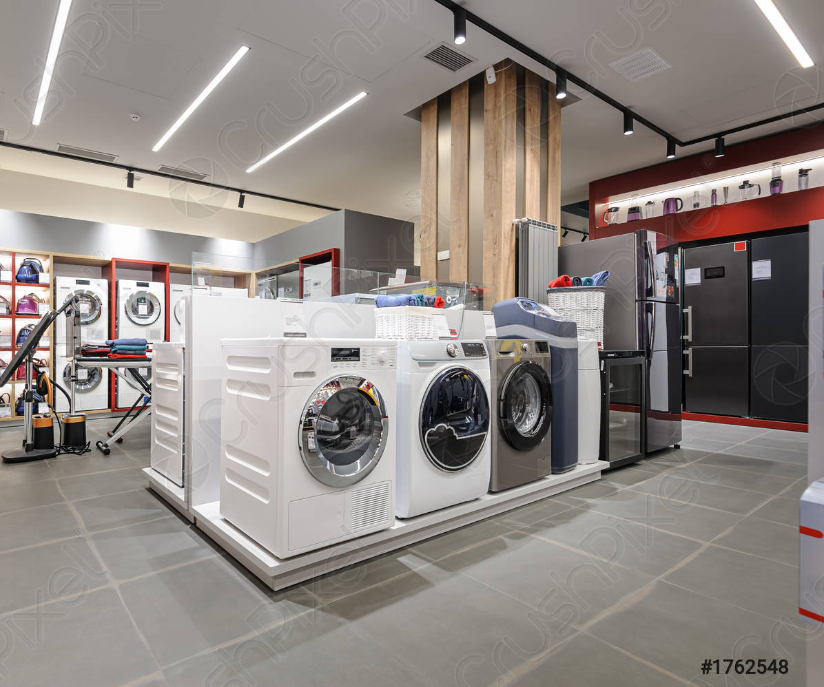
Our Data
Our original data was a csv file with 27GB containing:
9 columns
21 Families of Products
178 Categories of Products
1 535 Brands Products
8 660 SKUs
410 Point-of-Sales
Sales data from almost 3 years

Slide 4


Data Preprocessing
Steps performed:
Regular expression (Regex) preprocessing
Feature downcasting
Data trimming
Data aggregation
Feature Engineering

Slide 5

Quarterly analysis
Solution implemented using:

Slide 6


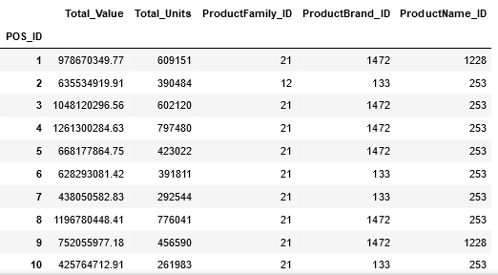
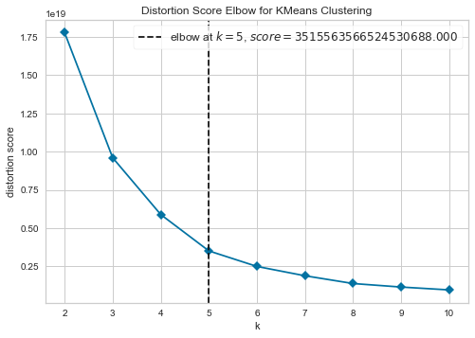
Clustering
K-Prototypes:
POS_ID as guide (groupby)
Metric Features: Total_Value, Total_Units
Categorical Features: ProductFamily_ID, ProductName_ID, ProductBrand_ID

Slide 7
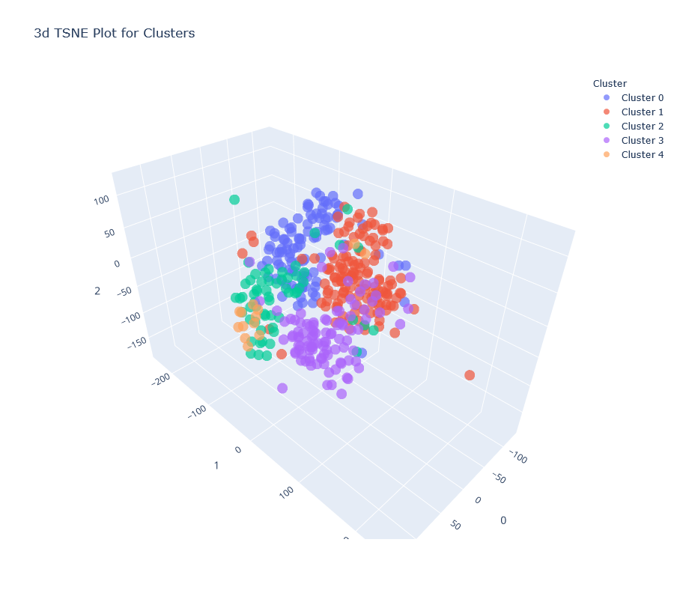
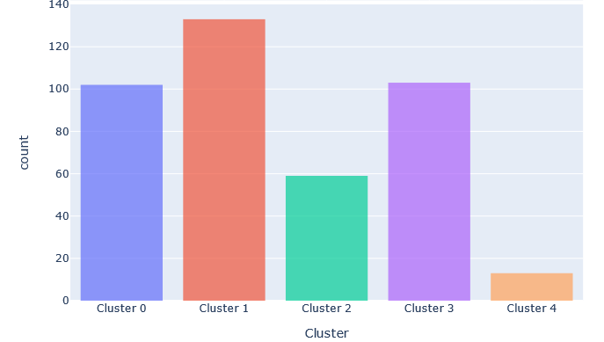
Clustering

Slide 8
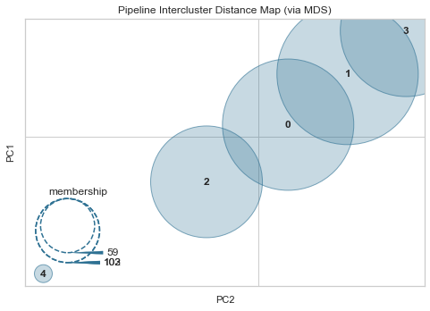
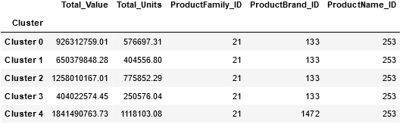
Clustering
Cluster 3: lowest value, less purchases
Cluster 4: highest value, more purchases, top Brand 1472

Slide 9

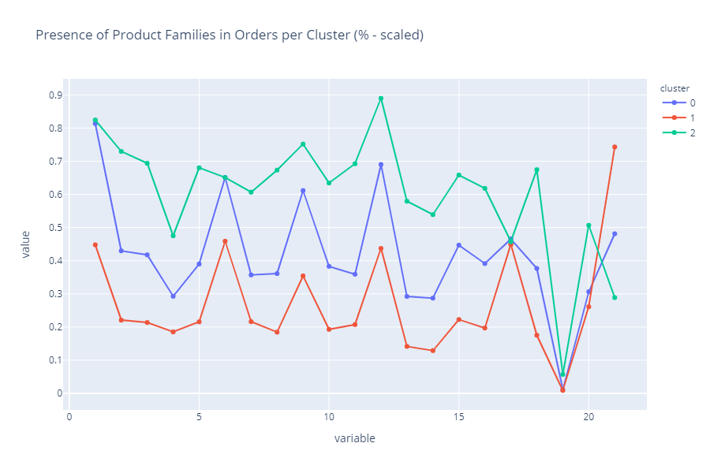
Clustering
Additional Solution (Feature Engineering + K-means):
Family Preference percentage for POS_ID

Slide 10

Predictions
Final preprocessing to trim the number of time series to predict (pair of POS-Product):
Removing discontinued products
3-fold Cross-Validation on a rolling basis
25 algorithms tested
MAE used to select algo for each time series

Slide 11
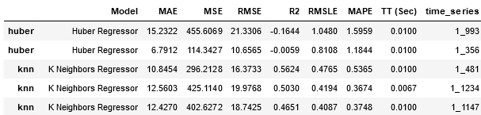
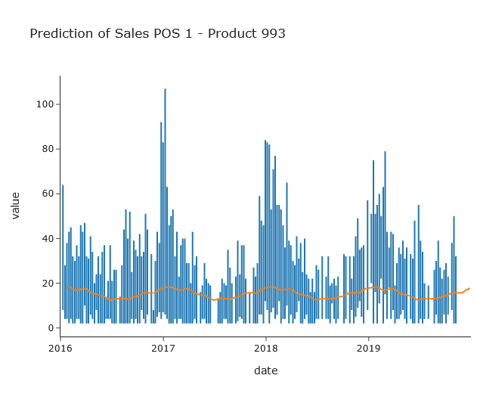
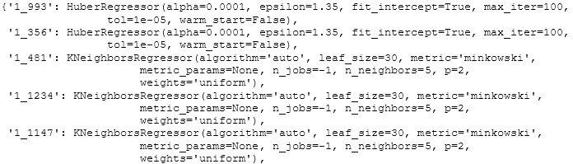
Predictions

Slide 12
Last remarks on VAR for COVID impact
Thank you!

